Slide 1
Lab 9 (Laravel Middleware)
CSE 3100 : Web Programming
Subah Nawar
Lecturer,
Dept of CSE, KUET
Email: nawar@cse.kuet.ac.bd
Kazi Saeed Alam
Assistant Professor,
Dept of CSE, KUET
Email: saeed.alam@cse.kuet.ac.bd

Slide 2
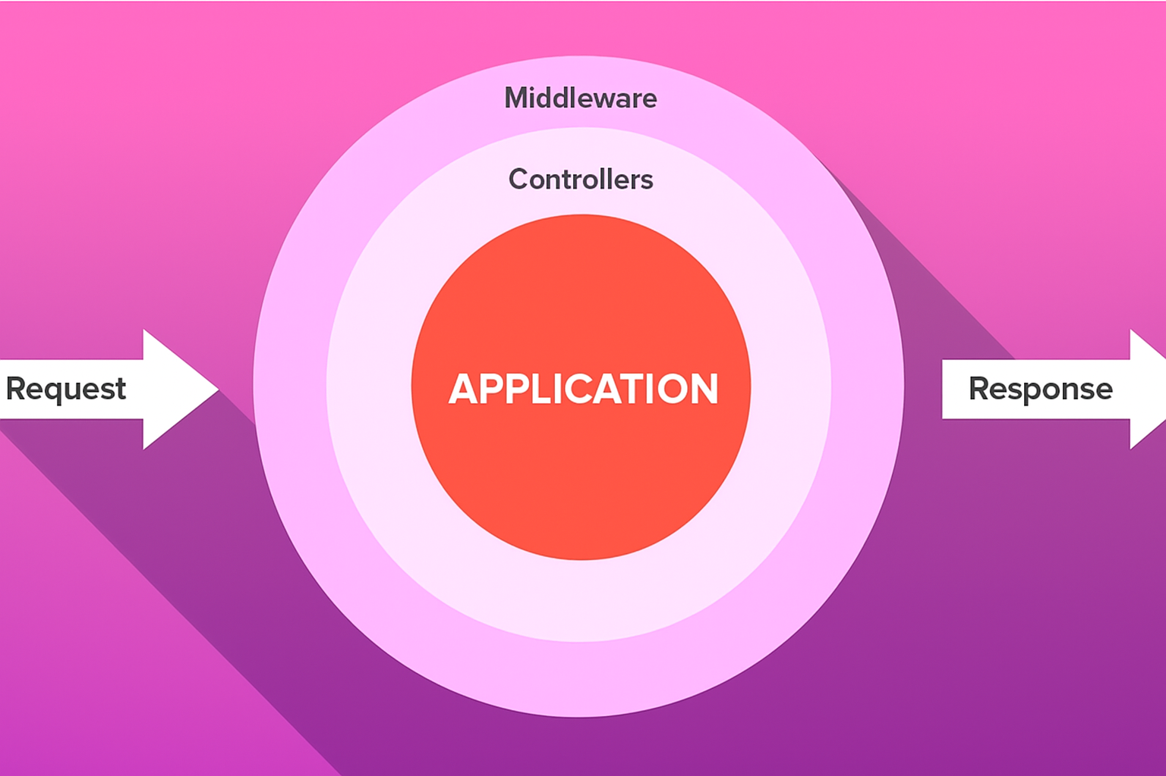
What is a Middleware?

Slide 3
Middleware
The conditions can be-
Authentication and authorization: Whether one is an authenticated user or not
Role or permission-based access control: Is Admin or not
Has ValidAge or not
Logging user activity
.

Slide 4
Types of Middleware
Route Middleware -> Applied to specific routes
Middleware Groups -> Applied to every request
Global Middleware -> Group multiple middleware under one key.

Slide 5
Middleware Commands
Basic Middleware:
php artisan make:middleware ValidUser
App/http/middleware/ValidUser.php
<?php
use Illuminate\Http\Request;
use Symfony\Component\HttpFoundation\Response; class ValidUser
{
public function handle(Request $request, Closure $next): Response
{
}
}
if (Auth::check()) {
return $next($request);
}
else{
return redirect()->route('login')
}

Slide 6
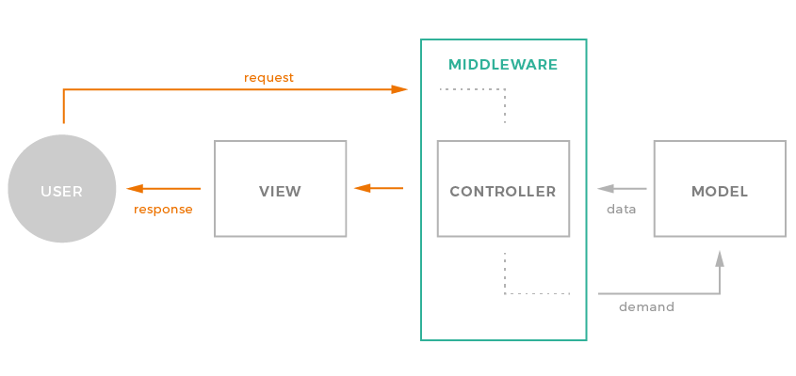
Middleware Commands

Slide 7
Route Middleware
routes/web.php
use App\Http\Controllers\UserController;
use App\Http\Middleware\ValidUser;
//Route::get('/dashboard', [UserController::class, 'dashboard'])->name('dashboard');
Route::get('/dashboard', [UserController::class,'dashboard'])
->name('dashboard')
->middleware(ValidUser::class);

Slide 8
Middleware Groups
Bootstrap/app.php
withMiddleware(function (Middleware $middleware){
$middleware -> appendToGroup ('ok-user',[
ValidUser::class,
ValidAge::class,
]);
})
Routes/web.php
Route::get('/dashboard', [UserController::class, 'dashboard'])->middleware(['ok-user']); //this will go through two condition check

Slide 9
Global Middleware
Bootstrap/app.php
//only one check globally
withMiddleware(function (Middleware $middleware){
$middleware -> append (ValidUser::class);
})
//more than one check globally
withMiddleware(function (Middleware $middleware){
$middleware -> use ([
ValidUser::class,
ValidAge::class,
]);
})

Slide 10
References
https://laravel.com/docs/12.x/authentication#main-content
https://laravel.com/docs/12.x/middleware

